Slide 1
Mentoring
During a Pandemic
In response to COVID-19

Slide 2
Our Commitment to YOU
Big Brothers Big Sisters of Vermont takes the health and safety of its Bigs and Littles very seriously. During a pandemic, and while social distancing measures are in place, BBBSVT reserves the right to modify its program scope, policies, and procedures to adapt to ever changing health and safety needs.
BBBSVT will adhere to federal, state, and local guidelines set in place to help ensure the health and safety of all participants and staff during times of pandemic.
CDC Guidelines
Vermont Department of Health

Slide 3
When “Stay at Home” Orders are in Place:
Bigs/Littles are not permitted to meet in person
BBBSVT physical offices will be closed and staff will work remotely
Participants will receive regular updates and instructions based on CDC guidelines
Staff will continue to communicate with all program participants via phone, email, text and through online meeting venues.
Bigs and Littles are expected to make every effort
to remain in touch while they are not able to meet in person.
BBBSVT staff are available to help facilitate Big/Little
communication if challenges arise.
BBBSVT will remain flexible and modify program rules
and guidelines as needed to remain in line with federal,
state, and local protocol.

Slide 4
How to Stay Connected while Social Distancing
Maintaining connection is critical to our health and well being, especially during challenging times. There are a number of ways to keep connected while “stay at home” orders are in place:
Use Zoom or Facetime to “meet” (with parent/guardian approval)
Call, text or send an email (with parent/guardian approval)
Mail a Care Package
Take a Virtual Tour online together
Start a Book Club online
Play Online Board Games
Exchange Letters or Postcards
Host a Netflix Movie Party
Learn a new Craft or Skill together (remotely!)

Slide 5
When Stay at Home Orders are officially modified
As Stay at Home orders are modified by federal/state/local health officials to include minimal in person contact, match outings may resume only under the following conditions: (matches may also opt to continue meeting virtually instead of in person)
All parties (Bigs/Littles/Parent/Guardians) must agree to resume in person meetings
All parties must complete the “Mentoring During a Pandemic” training prior to meeting in person
Matches may only participate in no contact activities that take place outdoors such as:
Walking, hiking, biking, fishing, sitting and chatting (6 feet apart)
Matches must adhere to social distancing measures at all times including:
Wearing CDC recommended cloth masks during all outings
Maintaining at least a 6 foot distance between Big, Little, and all others.
Hand washing before and after outings for at least 20 seconds
*timeframes and conditions are subject to change based on current federal, state, and local government recommendations*

Slide 6
When Stay at Home Orders are officially modified, cont.
In person meetings are strictly prohibited when a Big/Little or a member of a Big or Little’s household have been diagnosed with or show signs of COVID-19.
BBBSVT does not recommend resuming in person meetings with a participant who is considered to be part of a “vulnerable population” while social distancing measures are in place.
In person meetings shall not take place if a Big/Little has COVID-19,
has been exposed to COVID-19, or has any of the following symptoms:
fever, cough, shortness of breath
chills, muscle pain, headache
sore throat, loss of taste or smell, or
other signs of respiratory illness
*timeframes and conditions are subject to change based on current federal, state, and local government recommendations*

Slide 7
If you or a family member are diagnosed with COVID-19
Bigs and Parent/Guardians must notify BBBSVT if they or members of
their household have been diagnosed with COVID-19.
Bigs and Parent/Guardians must also notify BBBSVT if they have had any
exposure to someone (family member, friend, coworker, etc.) diagnosed
with COVID-19.
Matches must wait 14 days after an exposure to COVID-19 to resume in
person meetings and continue to follow all social distancing guidelines.
Please visit the CDC website at https://www.cdc.gov/coronavirus/2019-ncov/index.html for further guidance on what to do if you are sick, or have been exposed or think you may have been exposed to COVID-19

Slide 8
How to Stop the Spread of Germs
Stay at least 6 feet apart (about 2 arm’s length) from other people
Cover your cough or sneeze with a tissue, then throw the tissue in the trash and wash your hands
When in public, wear a cloth face covering over your nose and mouth
Do not touch your eyes, nose, and mouth
Clean and disinfect frequently touched objects and surfaces
Stay home when you are sick, except to get medical care
Wash your hands often with soap and water for at least 20 seconds
Source: https://www.cdc.gov/coronavirus/2019-ncov/downloads/stop-the-spread-of-germs.pdf

Slide 9
Social distancing means:
Wear a face covering when you go out around others
Keep six feet away from others
TIP: Keep a tape measure or 6 ft of yarn, twine, or string in your car to map out what 6 ft apart looks like (it’s about two arm’s length apart)
Source; https://www.healthvermont.gov/sites/default/files/documents/pdf/SM-COVID%20I%20ll%20protect%20you-English.pdf

Slide 10
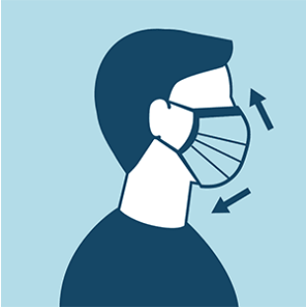
How to wear a cloth face covering
Cloth face coverings should:
Fit snugly but comfortably against the side of the face
Be secured with ties or ear loops
Include multiple layers of fabric
Allow for breathing without restriction
Be able to be laundered and machine dried without damage or change to shape
When removing your mask:
Do not touch your eyes , nose and mouth when removing it
Immediately wash your hands
Don’t put it where others can touch it or on counter tops or tables
Source: https://www.healthvermont.gov/sites/default/files/documents/pdf/COVID-19-VDH-mask-guidance.pdf

Slide 11
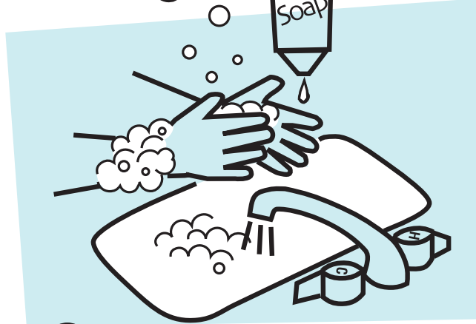
How to properly wash your hands
Use warm water
Moisten hands and apply soap
Rub hands together for 20 seconds
Rinse thoroughly
Dry hands thoroughly
When soap and water are not available:
You can use an alcohol-based hand sanitizer that contains at least 60% alcohol if soap and water are not available.
Apply the gel product to the palm of one hand Rub your hands together.
Rub the gel over all the surfaces of your hands and fingers until your hands are dry. This should take around 20 seconds.
Source: https://www.cdc.gov/healthywater/hygiene/hand/handwashing.html

Slide 12
Transporting Littles to and from outings
BBBSVT does not recommend Bigs transport Littles at this time and strongly encourage Parent/Guardians provide child transportation to and from outings while social distancing measures are in place.
When a Big does transport their Little, they must take reasonable steps to disinfect surfaces before and after transporting (wiping/spraying handles, dashboards, seatbelts, etc.);
Bigs should limit transport to short distances only and not travel across state lines;
Littles must sit in the back seat of the car; and
Masks must be worn by all parties during the entire transport period.
Source: https://www.cdc.gov/coronavirus/2019-ncov/community/organizations/rideshare-drivers-for-hire.html

Slide 13
Working together during this time is especially important and we thank all of you for remaining flexible as we all navigate through unprecedented times.
As always we are #BiggerTogether!

Slide 14
Additional Resources
Vermont’s Stay Home Stay Safe Order:
https://governor.vermont.gov/press-release/governor-phil-scott-issues-%E2%80%9Cstay-home-stay-safe%E2%80%9D-order-directs-additional-closures
Vermont Department of Health: https://www.healthvermont.gov/response/coronavirus-covid-19
Center for Disease Control and Prevention (CDC:) https://www.cdc.gov/coronavirus/2019-ncov/index.html
Mental Health Resources: https://mentalhealth.vermont.gov/sites/mhnew/files/documents/News/DMH_Corona_Virus_Overview.pdf
VOSHA PLAN for employers/employees: https://labor.vermont.gov/vermont-occupational-safety-and-health-administration-vosha
BBBS of Vermont
PO Box 1729, Brattleboro, VT 05302
Phone: 802-689-0092
Email: info@bbbsvt.org
Website: www.bbbsvt.org
Facebook: https://www.facebook.com/IgnitePotentialVT/
Offices locations in Brattleboro, Burlington and Newport

